Slide 1
Tips for Getting Ready to Go To College
& what to do when you first get there

Slide 2
Being successful in any environment
Keep track of your grades and class credits
Do not rely on a counselor or someone else to do this for you
Write a reflection about the grades you want to improve
Include what happened – take ownership of the grade
What will you do to improve the grade – be specific
Write letters to yourself to keep yourself on track
At the beginning of every year write a letter about what you hope to accomplish then read it at the end of the year to see if you stayed on track
Write down your dreams and goals – it really works

Slide 3
Research your top favorite schools
Making a Vision Board can be really helpful. The more colorful and visually appealing, the better!
Include the following:
Logo for the college or university you want to attend
The mascot and colors of the school
Anything special about the school or why you want to be there.
A picture of where you want to live (City, State, Country, apartment, dorm, etc.)
A description of who you think you will be during your college life
One word you will use to describe yourself as a college student

Slide 4
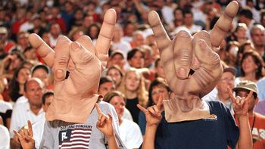
Congratulations!!
Send deposit
Buy sheets!
You are going to college!
Fill out roommate form

Slide 5
It’s OK to be Undecided!
Up to 80% of students begin college without knowing in what subject or discipline they want to major.
Up to 50% of college students change their major after declaring one, and many students change their major more than one time.
Employers have said that when considering candidates for a job, communication skills are most important – even more important than experience.
A study found that, on average, history majors who went on to pursue careers in business ended up with about the same pay as business majors did.

Slide 6
A Word on Passion
“Follow your passion” – or so the saying goes. But what, if among your many interests, none stands out as your sole driving passion? Don’t worry. In his research, Georgetown University professor Cal Newport has found that many people are without a calling for a specific type of work. Furthermore, having an interest in a particular field does not mean that you have what it takes to succeed in that field. It takes much more than just a passion for writing, for example, to succeed as an editor. The smartest goal, says Newport, is to develop your skills. Your passion will follow.
Notes:
For those students who don’t know what they want to do, this is incredibly comforting.

Slide 7
“The thing about goals is that living without them is a lot more fun, in the short run. It seems to me, though, that the people who get things done, who grow and who make an impact…those people have goals.”
– Seth Rogan
Notes:
Love this quotation. Think of any movie star, athlete or politician. They had goals.

Slide 8
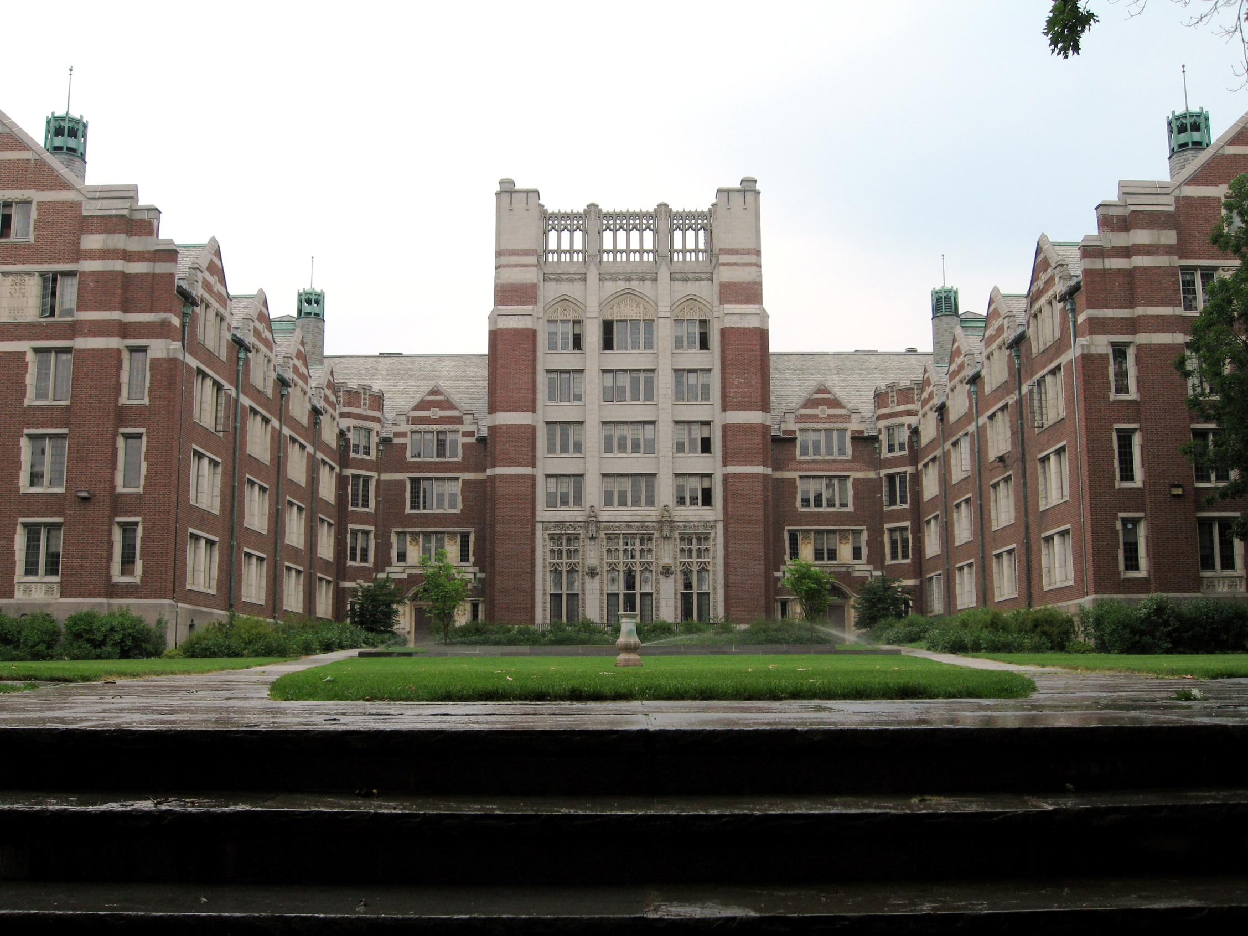
Things to do when you first get to college

Slide 9
1. What is the first thing you should do when you get on campus?
Get an ID card! Be the first in line, not the last. You’ll need it for meals and to get into your dorm.

Slide 10
2. What if your grandmother wants to send you cookies?
Find your mailbox! You have one, somewhere on campus. Sometimes the college will send you letters about important things like financial aid so you want to know where that box is.

Slide 11
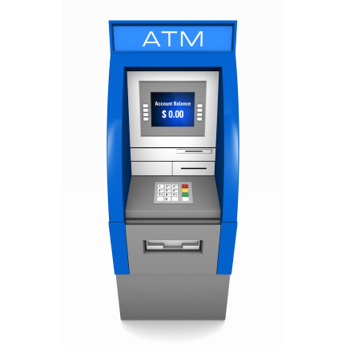
3. How do you pay for things?
Find your bank and/or ATM. Beware of using an ATM not connected to your bank – they will charge you a fee and your bank will too. That $20 withdrawal can actually cost you more than $25!

Slide 12
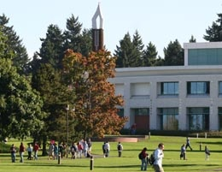
4. How do you explore your environment?
Take a walk! Figure out where your classes are so you aren’t frantic on the first day. Find the Student Union, dining hall, bookstore. Studying in your dorm room is hard so look for a quiet spot to study too.

Slide 13
5. Classes? What classes?
Check in with the Registrar or your Advisor. If you have AP or dual credits, make sure you aren’t taking (and paying for) a class you already have credit for.

Slide 14
6. Why can’t we be friends?
Be social. Make friends. You are more likely to stay in college and graduate if you have a good group of friends. Plus, it’s more fun!

Slide 15
“Whether you think you can or think you can’t, you are right.”
- Henry Ford

